Slide 1
Agent-Based Simulation
OPER 561 Discrete-Event Simulation
Lesson 19
Notes:
After lecture, exam study guide review & project time

Slide 2
Lesson objectives
Learn how agent-based simulation differs from discrete-event simulation
Understand that systems of simple interactions can lead to emergent complex behavior
Notes:
Key purpose is general awareness. There’s decent overlap between ABS & DES, but enough differences for it to be its own thing (& outside the real scope of this course).

Slide 3
Agent-Based Simulation
Agent-based simulation basics
Cellular automata
Military applications

Slide 4
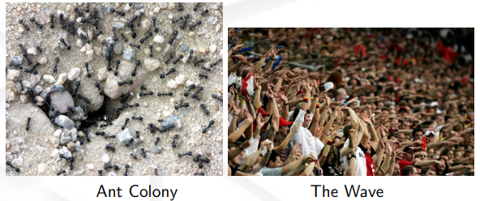
Examples of agent-based systems are quite common in natural systems

Slide 5
Agent-based simulation (ABS) models specific behaviors of specific individuals
Agents (entities) act autonomously & interact
The aggregate behavior of the system is due to interactions of simple behaviors of agents
You can think of it as a bottom-up approach, while DES are usually constructed top-down

Slide 6
ABS _{focuses on} agents DES processes
This is the key difference!
Agents posses more autonomy in movement & decision making than typical DES entities
ABS can use DES techniques, such as event calendars to coordinate interaction

Slide 7
An agent-based model has agents, relationships, and their environment
Agent relationships & methods of interaction are critical to the operation of an ABS
These interactions are based on agent behaviors and can modify their attributes

Slide 8
Agents are…
Adaptive
Autonomous
Heterogeneous
They can learn & modify their rules over time
They “decide” when to act, rather than a central process
They can possess many different “entity types,” attributes, rules, etc.
Notes:
This doesn’t make them intelligent, in the AI/ML sense of the word, though such sophisticated models could exist

Slide 9
ABS is well-suited to problems with a natural representation of interacting entities
Dynamic relationships (forming & breaking) between entities are especially important We also care about organizations & motion
Structural changes in the system are a result of the model—not an input!

Slide 10
The complexity of our world & the systems we want to study motivate the use of ABS
Fragmented consumer markets, interwoven industrial supply chains, transportation nets…
We could model such systems with traditional tools, but we assume away most of the details
Simplifying assumptions → loss of insights Particularly emergent behaviors

Slide 11
Studying complex adaptive systems (CAS) led to development of agent-based modeling
Key concept
CAS are present in nature Ant colonies, for example
System reactions are more than the sum of the individual component actions
This presentation of complexity is known as emergent behavior
Notes:
Holland’s CAS characteristics:
Aggregation
Nonlinearity
Flows
Diversity
Mechanisms:
Tagging agents for identification
Agents have internal models to “reason” about their environments
Building blocks allow components/systems to be built up from simple bits

Slide 12
Agent-Based Simulation
Agent-based simulation basics
Cellular automata
Military applications
Notes:
Aside: https://www.youtube.com/shorts/fK1VmX9mzRw

Slide 13
Cellular automata are the simplest form of agent-based modeling & simulation
They have very simple agents, often represented as cells in a grid
Their behavior is based on a small set of rules, responding to local conditions
Their collective behavior forms a complex adaptive system → emergent behavior! Generally unpredictable patterns arise

Slide 14

Conway’s Game of Life is the classic cellular automata (though it’s not much of a game…)
Each cell in a 2D grid is an agent with entirely deterministic rule-based behavior
Agents are either on or off and may change state at each time step
If off and has 3 on neighbors → on If on and has 2 or 3 on neighbors → on Else → off
Can model population effects, finite resources
Notes:
Image: tenor.com
This simulation is a simple way to show the population effects of overcrowding or lack of population density across a wide area...simulating competition for finite resources and/or lack of breeding opportunities within a species

Slide 15
Schelling’s Segregation Model explores self-segregation of a population
Like with Game of Life, agents live on a grid
They have two states {happy or unhappy} and belong to a group {majority or minority}
If % of neighbors that are from the agent’s group exceeds a threshold → happy
If unhappy → randomly move to new grid cell
Notes:
Iterate until all agents are happy
Note: The model demonstrates a strong tendency for populations to self-segregate, even with very low likeness thresholds
Goto Python demos of Conway’s & Schelling’s models (Canvas ‘examples’ folder)

Slide 16
Agent-Based Simulation
Agent-based simulation basics
Cellular automata
Military applications

Slide 17
The most important—& difficult—part of conflict to model is interaction of the entities
Entities adapt during conflict in response
Military agents are organized into hierarchies across space/time that have feedback loops
Behavior-driven effects (may) dominate issues related to transformational warfare
System performance: still important, but…
Notes:
This is not to suggest that system performance data is unimportant, but rather that it is secondary to how the systems are fought and the actions and reactions associated with their employment

Slide 18
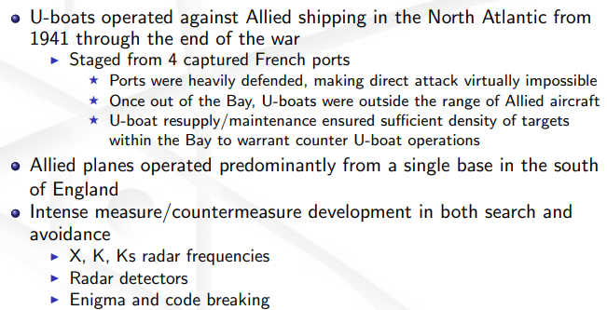
Example: Bay of Biscay U-Boat Suppression Dr. Champagne’s AFIT dissertation work
Notes:
Champagne, Lance. 2004. Development Approaches Coupled with Verification and Validation Methodologies for Agent-Based Mission-Level Analytical Combat Simulations. PhD dissertation. Air Force Institute of Technology: Wright-Patterson AFB, OH. AFIT/DS/ENS/03-02.

Slide 19
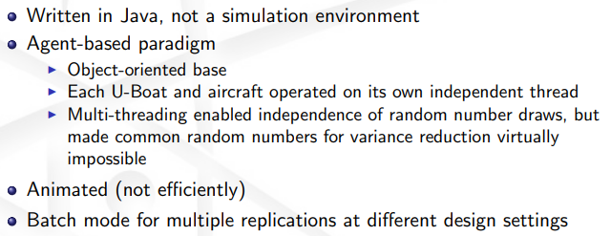

Slide 20
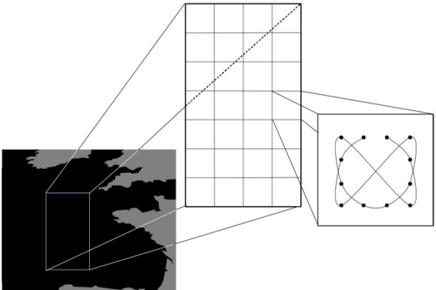
Allied aircraft executed search patterns to try to detect U-Boats at the surface

Slide 21
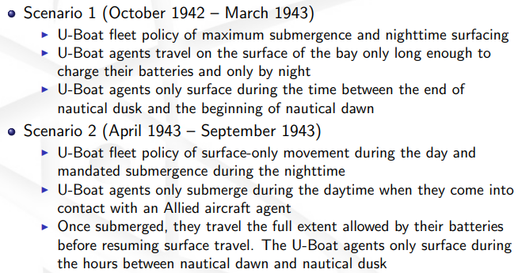
Both aircraft and U-Boats were modeled as agents with autonomous and distinct behavior
Notes:
This is the source of the data we used for Bonferonni/simultaneous comparisons in Excel last week

Slide 22
Agent-Based Simulation
Agent-based simulation basics
Cellular automata
Military applications

Slide 23
Lesson objectives
Learn how agent-based simulation differs from discrete-event simulation
Understand that systems of simple interactions can lead to emergent complex behavior
Notes:
Exam study guide review, then group project time

Slide 24
Learning outcomes: At the end of this course, students will be able to:
LO 1. Construct or modify a simulation model in response to a system description using discrete-event simulation methodology.
LO 2. Differentiate between important and trivial sources of randomness or variability in real-world processes.
LO 3. Describe the theory behind popular random variate generation techniques and understand how they are implemented in computer simulation.
LO 4. Analyze the output of a computer simulation to estimate system performance parameters.
LO 5. Evaluate alternative system designs using simulation.
LO 6. Carry out the process of model verification and validation.

